Slide 1

Optimization Algorithms
The problem of
local optima
deeplearning.ai

Slide 2
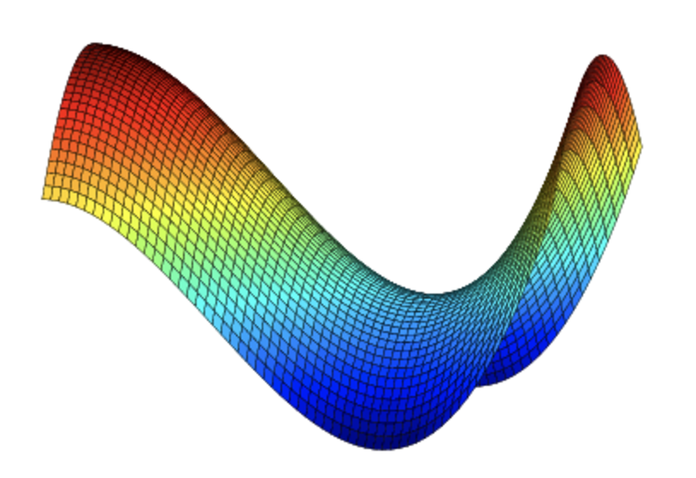
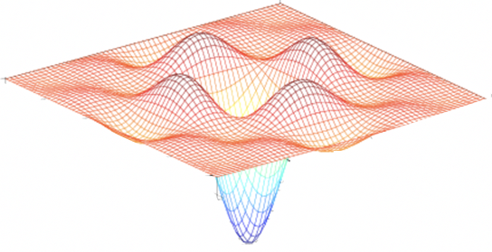
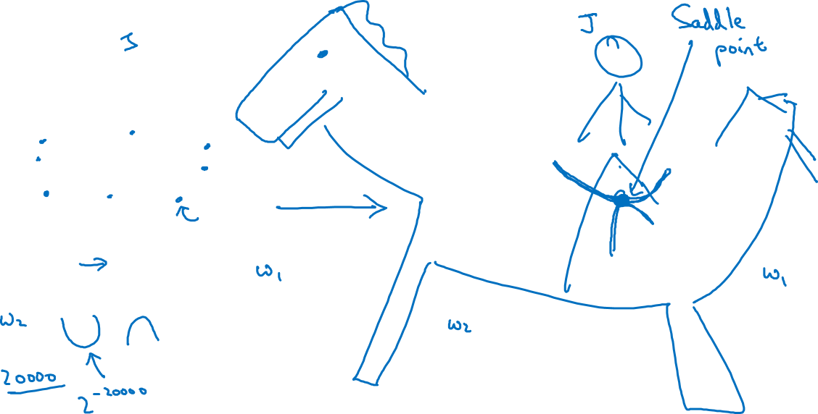
Local optima in neural networks

Slide 3

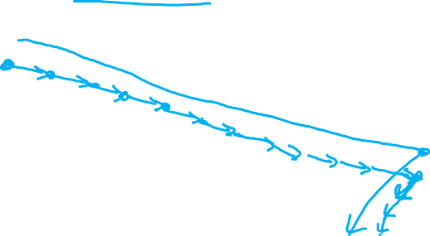
Problem of plateaus
Unlikely to get stuck in a bad local optima
Plateaus can make learning slow

